Slide 1

Phase-I Choose research Area Training / Inference in noisy environments and incomplete data
Guided by: Dr. Sabah Mohammed
Mohan Prasad Kutala
mkutala@lakeheadu.ca

Slide 2
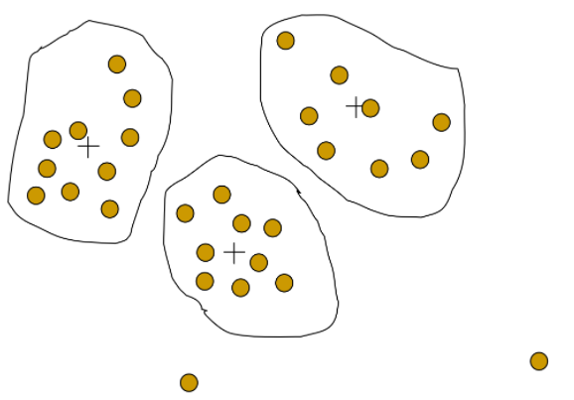
Noisy Data
What is noisy data
Noisy data is meaningless data. Noisy data can be stored, received or change the existing data that machine or program will run on it to provide unsatisfied or unexpected results
How noisy data will add to the existing data
Noise is only added during the training of your model.
How we have to train the noisy data.
Experiment with different amounts, and even different types of noise, in order to discover what works best
How to reduce the noisy data if we have in our data set.
use noise reduction techniques to minimize the noise level in the data
replace the unknown values with zeros or nan
Kalman filter and Savitzky-Golay filter for audio and video
Image referred from: http://www.lastnightstudy.com/Show?id=38/Data-Cleaning-in-Data-Mining

Slide 3
Background
selected Health care Department to do my research
EHR (Electronic health records) it might be diabetes, heart diseases, Allergy information, Emergency department visits, Hospital discharge summaries and reports, Drug and Pharmacy Service Information , Neurophysiology reports, Patient consultation reports etc.,
EHR Data can come from many different sources in today's world. Data such as:
• Heart rate monitors
• X-Rays and other radiology scans
• Fitness trackers
• Other diagnostic tests

Slide 4
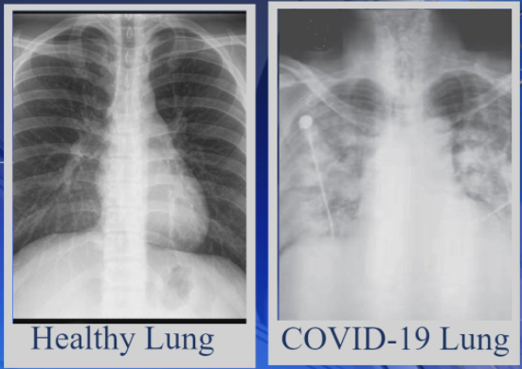
EHR and Chest X-Rays
world suffering from dangerous virus called COVID-19
this virus will infect all tissues inside the lungs
doctor will do chest x-ray scan to measure the severity of the disease and infection inside the lungs
Above Image referred from : https://www.wlox.com/2021/01/16/covid-patients-have-persistent-symptoms-weeks-or-months-after-diagnoses/

Slide 5
Research Area
X-Rays to know the severity of the disease and level of infection inside the body
we can use X-rays to analyse the health of a patient’s lungs
public can alert and have a chance to consult or ask doctor for remedy for the damage
X-ray images as doctors frequently use X-rays and CT scans to diagnose pneumonia, lung inflammation, abscesses, and enlarged lymph nodes
A drawback is that X-ray analysis requires a radiology expert and takes significant time which is precious when people are sick around the world
So, developing an automated analysis system is required to save medical professionals valuable time.

Slide 6


